Slide 1
Sign & Spell VR Irish Sign Language Learning in Virtual Reality
Karl Negrillo
C22386123
BSc Computer Science International
Supervisor: Colette Kirwan
Notes:
Thank you for having me today. My name is Karl Negrillo and I am presenting my project Sign and Spell VR – An immersive virtual reality application for learning Irish Sign Language.
Let me talk about my project.

Slide 2
Project
VR app using hand tracking.
Teaches Irish Sign Language alphabet, words, maybe even sentences.
Meta Quest 3/3S with real-time feedback.
Local Progress Tracking.
Notes:
So, what is Sign & Spell VR? At its core, it's a virtual reality application that uses hand tracking to teach people Irish Sign Language. You put on a Meta Quest 3 headset, and instead of holding controllers, the system tracks your actual hands—your fingers, your palm position, everything.
The app teaches you the ISL alphabet. You practice signing letters from A-Z and the system gives you immediate feedback—it tells you if you got it right or wrong, right there in the moment. No waiting. No guessing.
As I develop it further, the plan is to expand from just letters to common words that the Deaf community actually uses, and eventually to simple sentences.
All your progress gets saved locally on the headset—it's your personalized learning environment. Each time you log in, the system remembers what you've practiced and where you left off. That's the vision. That's what I'm building.

Slide 3
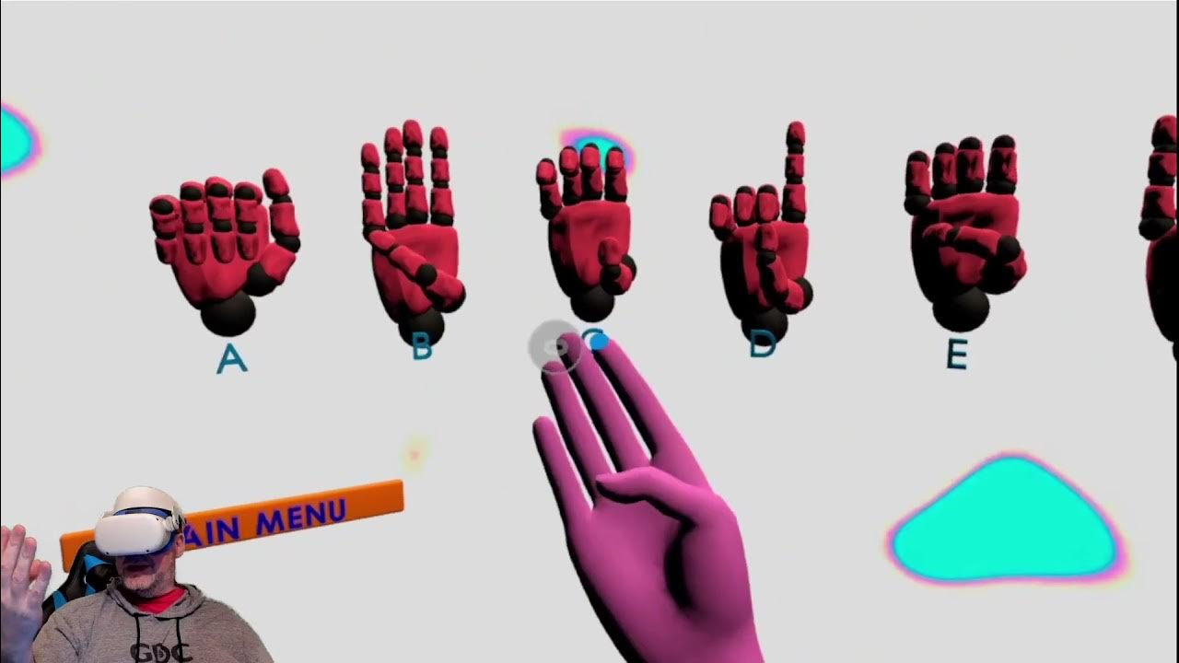
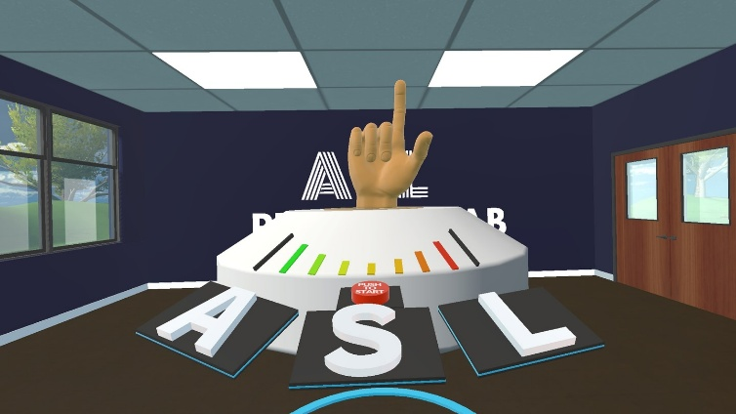
Background
Existing Solutions: ASL FingerSpeller, Silent Classroom VR
Why Different:
ISL Focus
Common Words, in the future, sentence making
VR Immersion
Less Common than ASL – Fills a Gap
Ethical Approach: Designed with Deaf community input, respects ISL cultural significance & accuracy (vs avatars as substitute)
Notes:
Let me give you some context. I have a deaf friend, and me myself, I don’t know the sign language. So now creating this app, I can learn on the way and not make him feel excluded with my friend group.
So I thought, I can create an app that lets users learn and practice the Irish Sign Language and test themselves.
Now, you might say, 'Karl, there are already sign language learning apps out there.' And yeah, there are. ASL FingerSpeller is great—it's a VR app where you practice American Sign Language fingerspelling. Silent Classroom VR puts you in a virtual classroom to learn ASL with hand tracking. Both are cool.
But here's the problem: Most existing apps focus on American Sign Language (ASL). ASL uses one hand, has different grammar, completely different from Irish Sign Language. And ISL is underrepresented in digital learning platforms. It deserves its own dedicated tool.
That's why I'm building this specifically for ISL. Not adapting an ASL app—building from scratch for Irish Sign Language with two-handed signing and ISL-specific grammar.
Additionally—and this is crucial—I'm taking an ethical approach. Sign language is culturally rich and linguistically complex. There's academic research that warns against treating it carelessly. I'm designing this with the Deaf community in mind, not replacing human interpreters with avatars, but creating a tool that respects the language and the culture.
A learner signs an 'A', gets instant feedback saying 'Correct!', feels a sense of progress, and is motivated to sign the next letter—that immediate feedback loop is backed by pedagogy research showing real-time feedback dramatically improves learning outcomes.

Slide 4
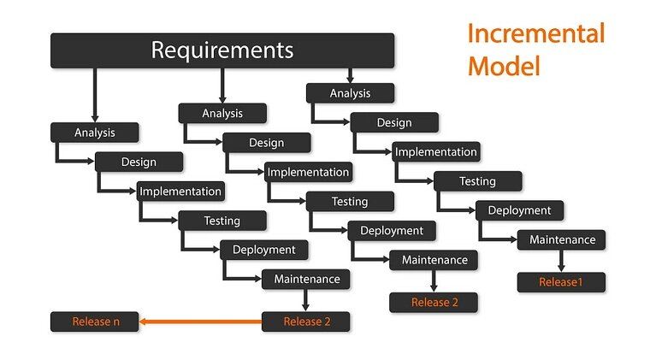
Methodology
Incremental Model
Core Features:
Increment 1: Real-Time Hand Tracking, recognition of basic ISL Letters, Real-Time Feedback
Increment 2: Common Words, Common Sentences, Improve UI
Increment 3: Data Saving
Notes:
Let's talk about how I'm building this. I'm using an Incremental Model. I’m thinking this like building layers.
Increment 1 (where I am now) focuses on the foundation: real-time hand tracking, recognizing all the ISL letters, and giving immediate feedback. Can the system track my hands? Can it recognize when I sign an 'A'? Does it tell me if I got it right? That's Increment 1.
Increment 2 about expanding capability: I add common ISL words, move toward sentence construction, and improve the overall UI so it doesn't look like a prototype anymore.
Increment 3 is about persistence and assessment: proper data saving, a testing module where users can assess their progress, and thorough user testing with real learners.
Why this approach? Because I can release working features early, get feedback from stakeholders, and adapt. Instead of showing up with a broken half-finished app, I'm showing you something that actually works—it's just not feature-complete

Slide 5
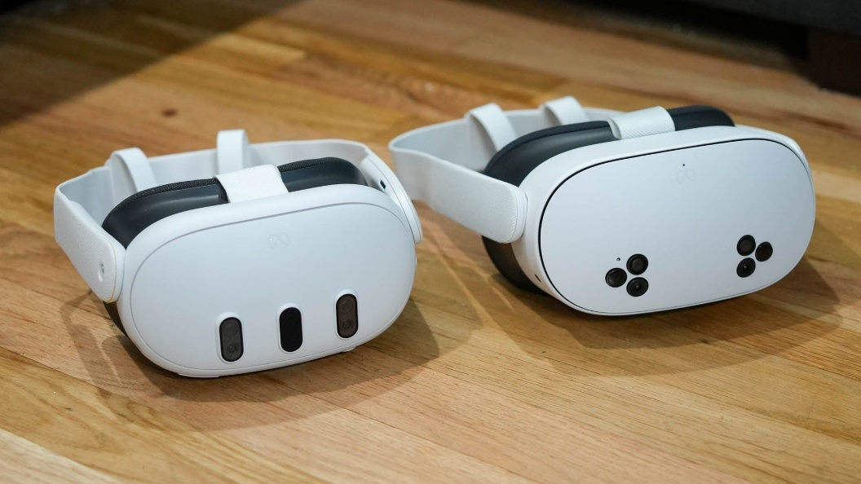
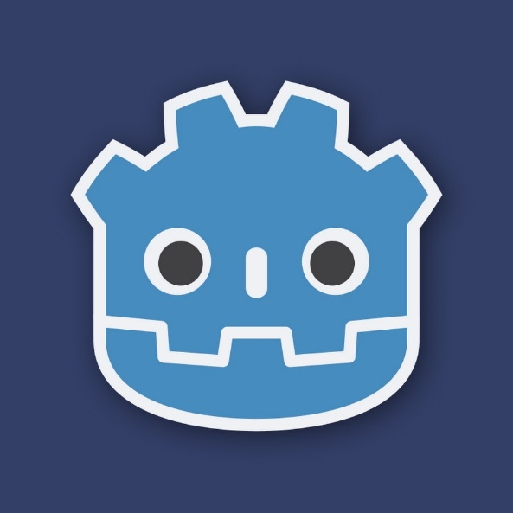
Technologies
Operating Systems(s): Meta Quest 3/3S (VR headset OS)
Programming Language(s): GDScript
XR Framework: OpenXR
Data Storage: JSON (local)
Game Engine: Godot 4
Notes:
Alright, tech stack time. Let me break down the tools I chose:
Meta Quest 3/3S — The VR headset. Why this one? It's standalone—meaning it doesn't need a powerful PC tethered to it. It has excellent hand tracking built-in. And it's increasingly used in education, so it's a practical choice for accessibility.
Godot 4 — The game engine. I chose Godot because it's free, open-source, and I'm literally learning it right now in my XR Prototyping module. It's got native support for VR, and the documentation for hand tracking is solid. Could I have used Unity? Sure. But Godot felt less overwhelming and more suited to this educational project.
GDScript — Godot's built-in programming language. It looks like Python, which I already know a bit of. Makes iteration fast, makes debugging easier, and it's tightly integrated with the engine
OpenXR — This is the bridge between Godot and the Meta Quest. OpenXR is an open standard that lets different VR hardware and software talk to each other. It's what gives me access to hand tracking data in real-time.
JSON (local storage) — For saving user data. Not a cloud database, not PostgreSQL—just JSON files stored locally on the Quest. Simple, effective, and scalable if I need it later.

Slide 6
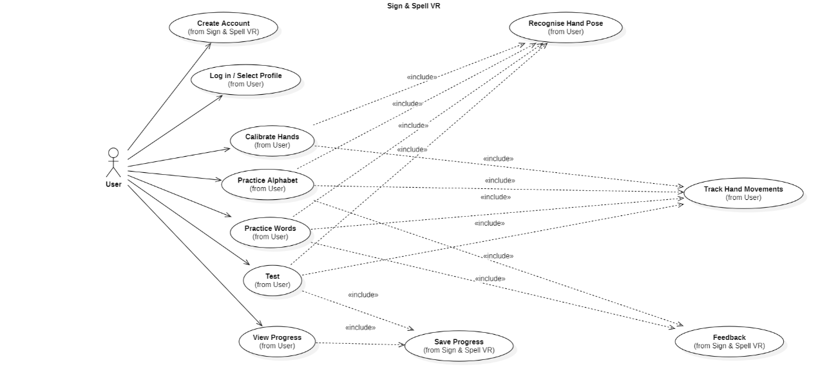
System Requirements
Requirements
Stakeholder Interviews: Learners, Deaf Community, Teachers
Functional
Hand Tracking, Sign Recognition, Feedback, Progress Storage
Non-Functional
Low Latency, accessible UI, intuitive design
Use Case Diagram
Notes:
Before I built anything, I had to ask: Who is this for? What do they actually need?
Stakeholders — That's learners (people wanting to learn ISL), the Deaf community (to make sure I'm not oversimplifying or misrepresenting their language), and teachers (who might use this in a classroom).
Functional requirements — These are the features that have to work:
Hand Tracking: The system must capture real-time hand position and finger orientation.
Sign Recognition: Compare user hand poses against a locally stored JSON library of correct ISL signs, designed so it can later sync with a cloud database
Feedback: Tell the user immediately if they got the sign right or wrong.
- Progress Storage: Remember what they've learned.
Non-Functional requirements — These are the qualities:
Low Latency: Hand tracking feedback must be instant. If there's a 500ms delay between me signing and the system responding, it breaks immersion and kills the learning experience.
Accessible UI: Clear, simple interface. Not cluttered. Easy to navigate even if you've never used VR before.
Intuitive Design: Users should figure it out without needing a manual.
I mapped out the main user interactions in a use case diagram. Basically, it shows: the learner creates an account, logs in, then the app guides them through hand calibration, practice sessions, testing, and progress tracking. Every action—whether it's practicing alphabet, practicing words, or taking a test—requires the same core system processes: track hand movements and recognize hand poses. So those two are the backbone. The feedback and saving data happen automatically after each action. It's not complex, but it shows how everything connects. The learner is at the center, and everything radiates from what they're trying to do.

Slide 7
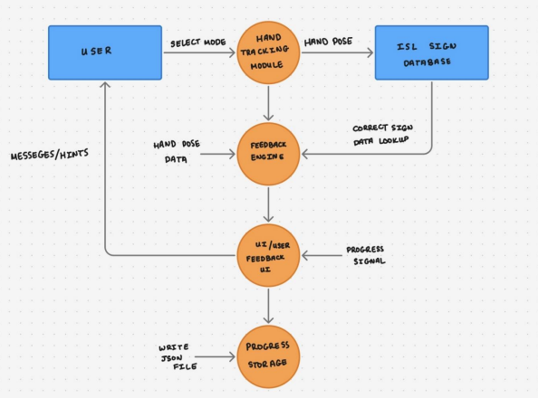
Technical Architecture
Standalone VR application on Meta Quest 3/3S
Hand tracking → Recognition → Feedback → Storage
Data Flow Diagram
Notes:
Let's zoom out and look at the big picture architecture
Hand Tracking — OpenXR sensors on the Quest track your hands in real-time. It's getting positional data constantly—where each finger is, what angle your hand is at, all of it.
Recognition — That hand pose data gets fed into my sign recognition system. I compare your hand position and shape to a stored JSON file of users calibration of ISL signs.
Feedback — If your pose matches a sign (within a confidence threshold), the system generates visual feedback. You see text on screen: "That's right! Well done." If it doesn't match, you get "Try again—remember the hand should be lower.“
Storage — Your progress and calibration data get saved to JSON files on the device, so next time you use the app, it remembers you.
This is all happening standalone on the Quest. No cloud calls (for now), no external servers. Everything runs locally. That means the experience is smooth, responsive, and doesn't depend on internet connectivity.

Slide 8
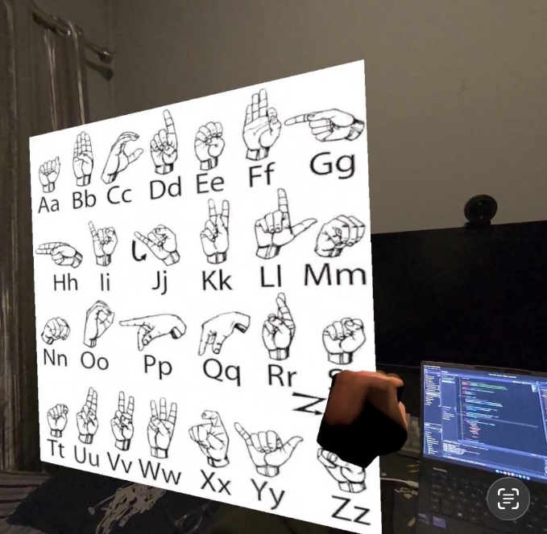
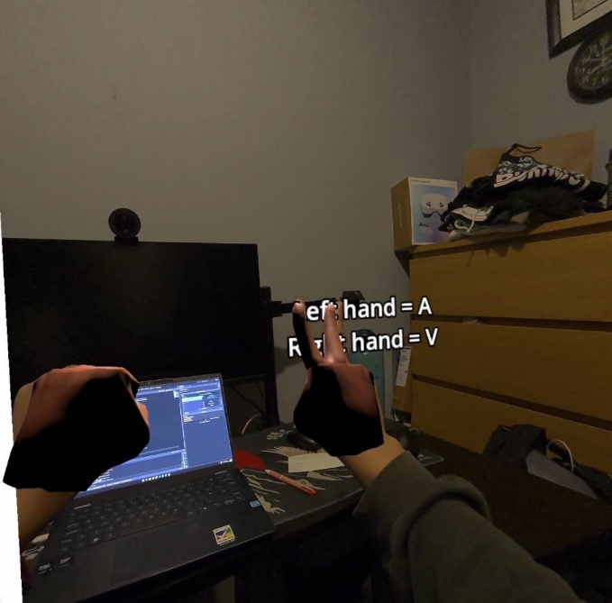
Front End Design
Simple VR room with floating ISL alphabet reference board.​
Passthrough view shows user’s real room plus virtual ISL hands.
Live virtual hands mirror the user’s hands for practice and feedback.
On‑screen text shows detected letters for each hand in real time (e.g. “Left hand = A, Right hand = V”).
Notes:
So, what does the user actually see as of now?
You put on the headset, and you are presented in your room. Not distracting. Minimal design. Off to the side, there's a floating reference board showing the ISL alphabet—a quick visual guide so you remember what the letter 'M' looks like, what 'P' looks like.
Passthrough camera: The Quest has a passthrough feature where you can see your real environment through the headset's cameras while also seeing virtual objects overlaid. So you see your actual hands in your actual room, but they're also being tracked and displayed in VR. It's less isolating than full VR, which is good for learning.
Live virtual hands: Your actual hands appear as virtual representations. You move your real hand, and you see it mirrored in the VR. Very intuitive—no controllers to learn.
Real-time feedback text: On screen, you see text updating: "Left hand = A, Right hand = V". As you change your hand shape, the text changes. Immediate feedback. You know the system is responding to you.
The whole design philosophy is: minimize cognitive load, maximize clarity. Don't make the learner think. Just let them practice and see if they're getting it right.

Slide 9
Middle Tier Design
Hand Pose Detection: OpenXR sensors detect finger positions in real-time
Gesture Matching: Compare user hand pose to stored ISL sign database
Confidence Validation: Check if pose matches threshold for correct/incorrect
Real-time Feedback: Generate visual feedback (correct/try again) instantly
Rule-based recognition: simpler, faster setup
Notes:
Now let's talk about the logic layer—the stuff happening in the middle that makes the app actually work.
Hand Pose Detection: OpenXR is constantly giving me data about the user's hand. X, Y, Z coordinates for each finger joint, palm position, rotation. This is streaming in real-time from the Quest's hand tracking sensors.
Gesture Matching: I take that hand pose data and compare it to a JSON library of users ISL signs after calibration. I'm using rule-based recognition. Basically, I'm saying: 'If the left hand is in a closed fist AND the fingers are pointing upward AND the wrist is at this angle, that's an A.' Simple if-then logic.
Confidence Validation: The system doesn't just say 'match found.' It checks: Does the match quality meet my confidence threshold? Maybe I require 85% similarity to accept a sign. If the match is only 70% similar, I say 'Try again.’
Real-time Feedback: As soon as validation happens, visual feedback appears. No lag. User signs an 'A', system recognizes it, text appears on screen: 'Correct!' All within milliseconds.

Slide 10
Back End Design
Local JSON files store user calibration, progress, and settings on the Quest headset.​
One JSON structure per learner: user info, hand‑pose calibration, learned alphabet letters, and simple stats.​
Accessed through Godot 4’s FileAccess API in the user data path (no external DB).​
Designed so the same JSON can later be sent to a cloud service for sync without changing the data model.​
Notes:
Im not using a fancy external database yet. Instead, we're storing everything locally on the Quest headset using JSON files.
So when someone uses the app, all their information—their calibration settings, what letters they've learned, their progress stats—gets saved in local JSON files directly on the Quest device. It's like a little database living on the headset itself.
Each learner gets one JSON structure. Think of it like a file folder for each person that contains: their user info, their hand calibration data (remember that calibration phase?), which alphabet letters they've practiced, and some basic statistics like how many times they've tried each sign.
Now, to actually read and write these files, we use Godot's FileAccess API. That's basically Godot's built-in toolbox for file operations. We point it to the user data path on the Quest, and boom—we can load their data when they start the app and save updates as they practice.
All though its not built yet, Right now it's local, but the same JSON structure we're using can easily be sent to a cloud service later—like Firebase or a custom backend—without changing our whole data model. So if we scale up and want cross-device syncing in the future, we won't need to rebuild everything.

Slide 11
DEMO HERE
DEMO HERE

Slide 12
Evaluation Criteria
“A”, “V”, and “D” is readable from hand-tracking on both hands.
Feedback works when user signs “A”, “V”, and “D”, shows Left Hand = “A”/”V”/”D” and Right Hand = “A”/”V”/”D”
User can complete a short practice session (A, V, D) without confusion or crashes.
Notes:
So, what was I evaluating with that demo?
Criterion 1: Can the system accurately recognize the letters A, V, and D from hand tracking on both hands?
Result: Yes. My left hand formed an 'A'—the system recognized it. Right hand 'V'—recognized. Both hands working independently and simultaneously. This is important because ISL uses both hands, often with different shapes.
Criterion 2: Does real-time feedback work correctly?
Result: Yes. You saw the text update on screen. When I signed correctly, it showed the detected letter. When I was fumbling around, it showed... nothing, because the pose didn't match anything. That's correct behavior.
Criterion 3: Can a user complete a short practice session without the app crashing or confusing them?
Result: Yes. I signed through all three letters smoothly. No crashes. The interface was clear—what I needed to do was obvious.

Slide 13
Future Work
Increment 2 (Immediate):
Complete remaining alphabet letters A-Z
Better Visualisation of the UI Environment
Increment 2 (Christmas):
Implementing User Account Creation and Hand Calibration
Implementing Common Words
Increment 3 (Post-exams: Late Jan–Late Feb):
Local Data Saving
Test Page
User testing & refinement

Slide 14
Thank you!
?
Questions
?

